Slide 1
Data, Environment and Society (ER190C) Lecture 1: Introduction
August 23, 2018
Instructor: Duncan Calllaway
GSI: Seigi Karasaki

Slide 2
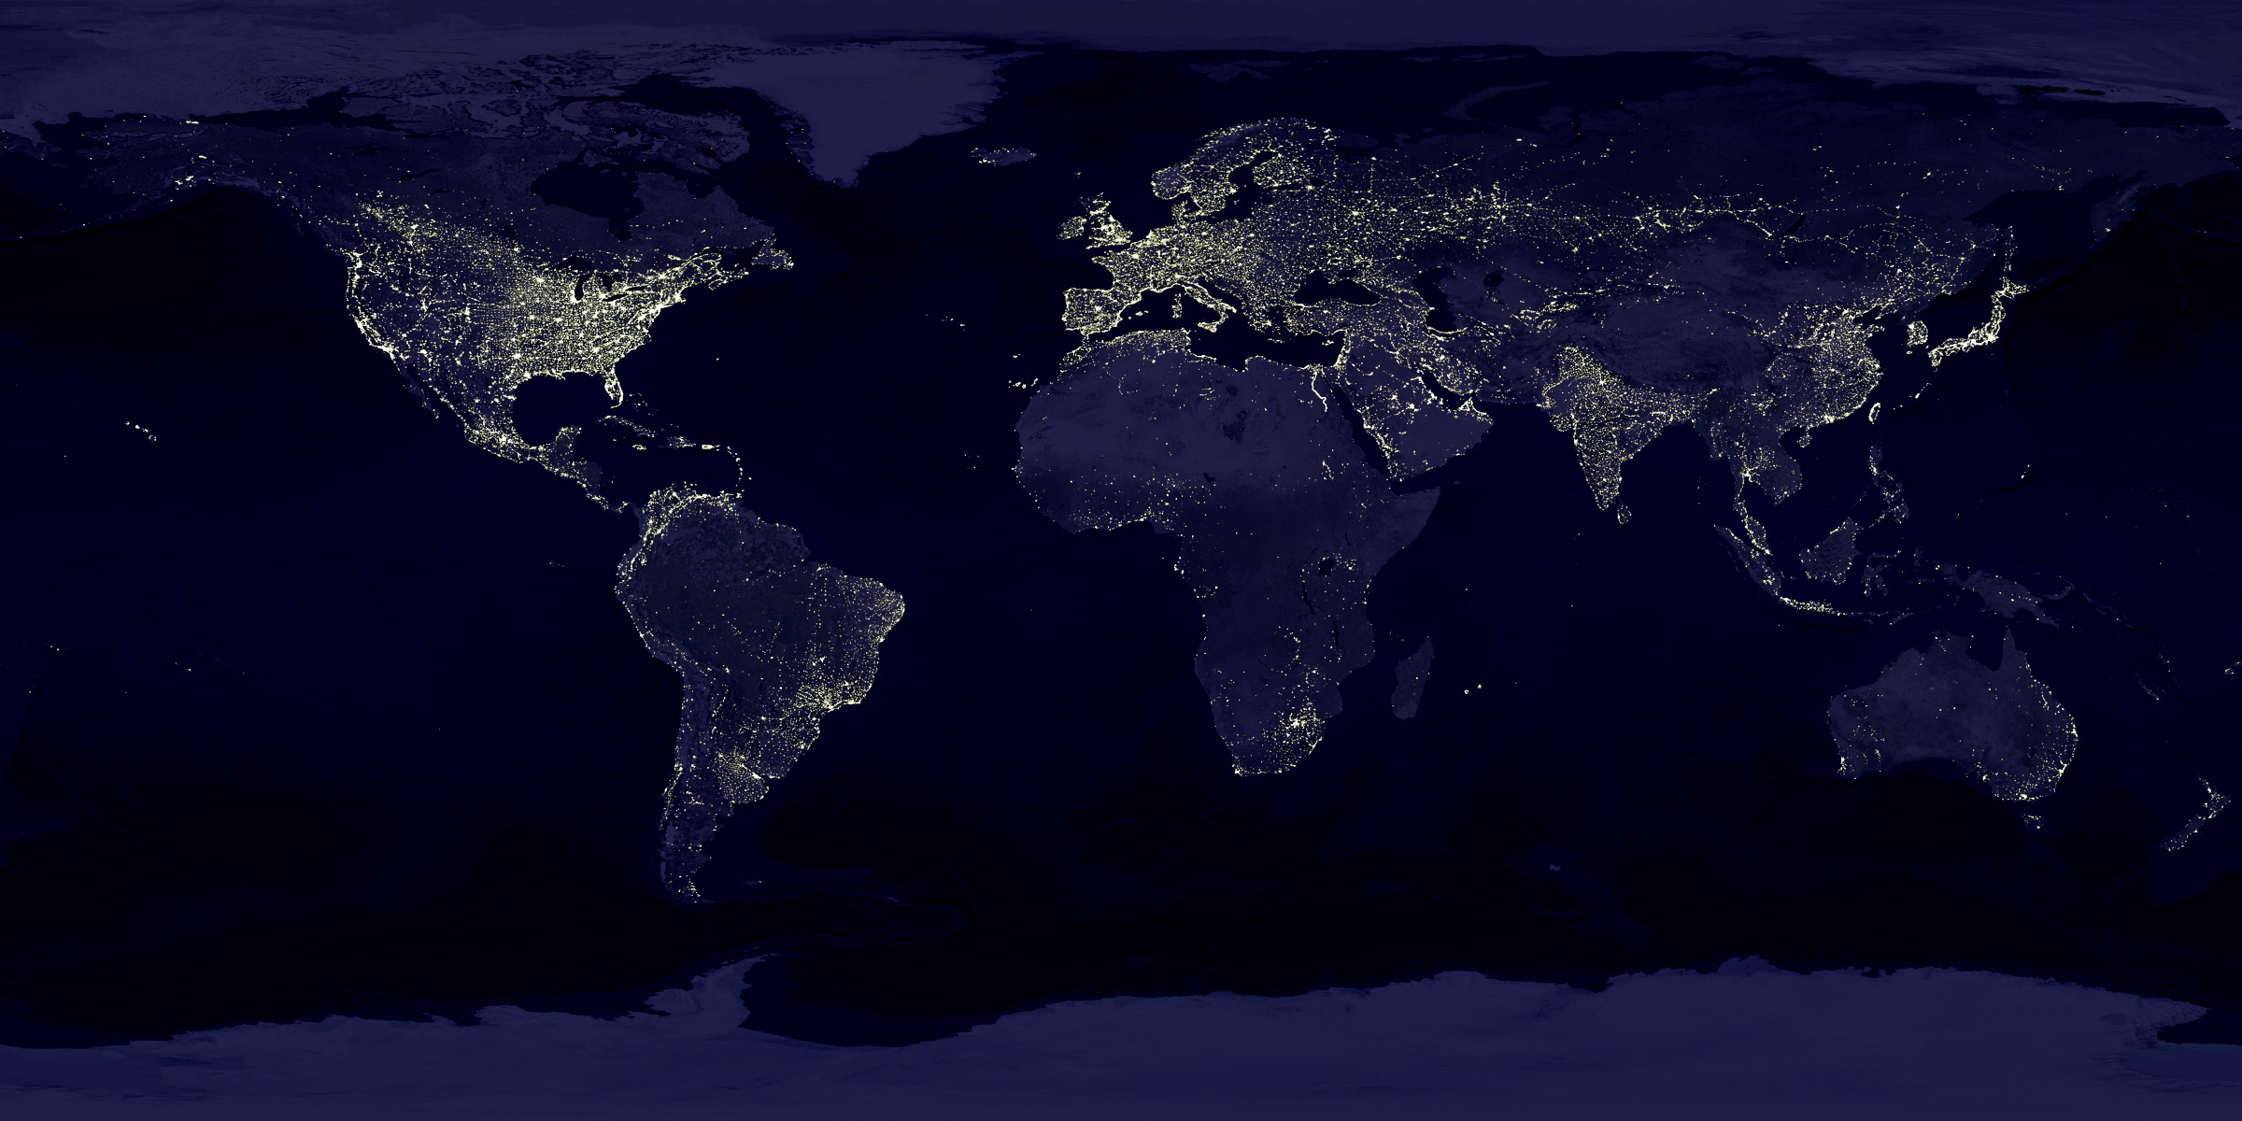
Why data, environment and society?
1. Energy conversion and use as at the core of core of nearly all societies
Notes:
But differences exist!
There are vast amounts of data available to explore and understand these differences.
But it is somewhat cumbersome to work with
A question we will explore: what is the relationship between energy and human development at the country level? What data are available to us to explore this question?
We’ll use Python and a package called Pandas to examine these data.

Slide 3
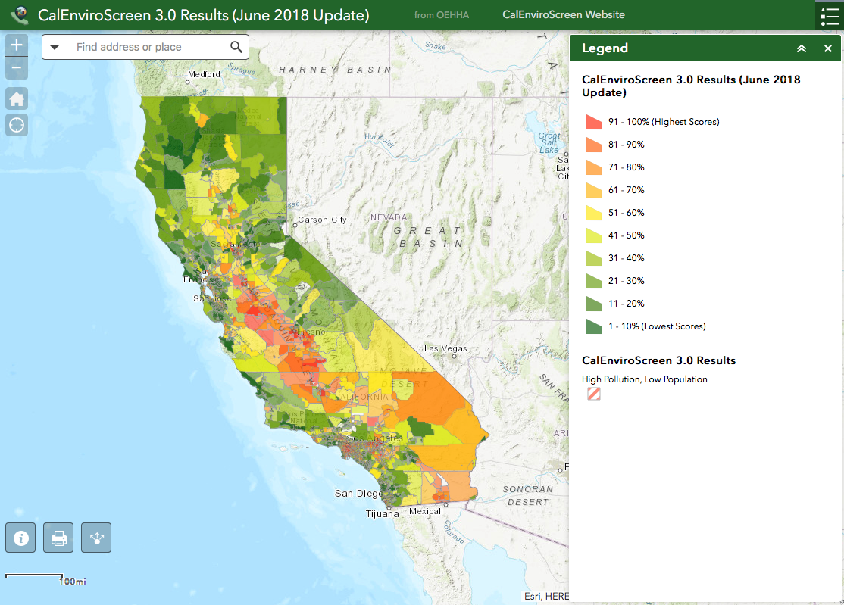
Why data, environment and society?
2. Energy consumption and other industrial activities generate pollution. Its distribution and impact are heterogeneously distributed.
Notes:
Pollution is heterogeneously distributed
This map is from the Califorina enviroscreen database. https://oehha.ca.gov/calenviroscreen/report/calenviroscreen-30
What are the implications?

Slide 4
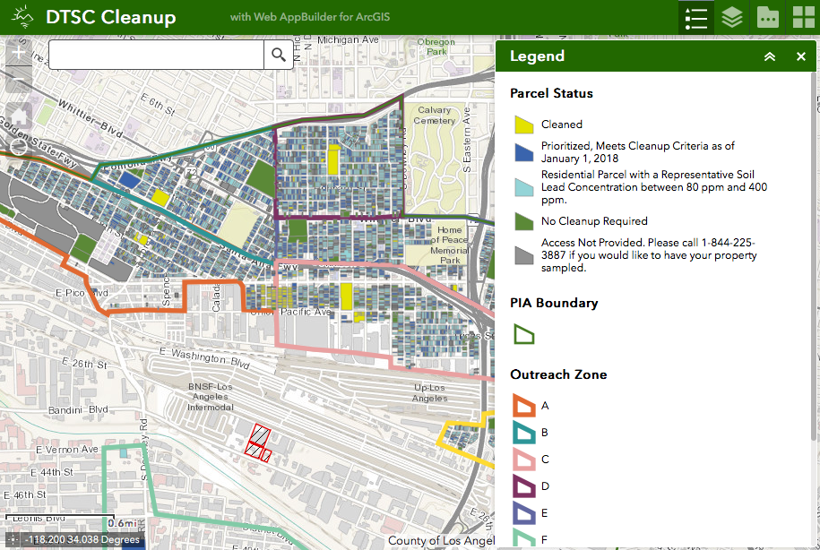

Why data, environment and society?
3. Data (and access to the data) to study these issues is growing
Notes:
Data availability growing due to improving access and also people generating their own new data sets…

Slide 5
Why data, environment and society?
4. There is an incredible growing toolkit available to anyone with a computer…
New Algorithms
Improving computing infrastructure
New analysis tools: Jupyter, Python libraries
Data availability

Slide 6
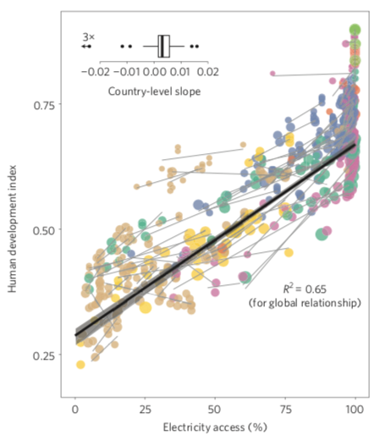
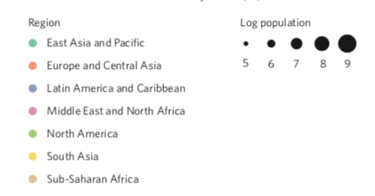
Example: Human development and energy
From Alstone, Gershenson and Kammen, Nature Climate Change (2015)
Notes:
The algorithms used here limited to regression
However the effort involved in
carefully constructing data sets from many different sources
Presenting data in a visually useful way
Question: What do you think this analysis can say about the underlying relationship between electricity access and the HDI?

Slide 7
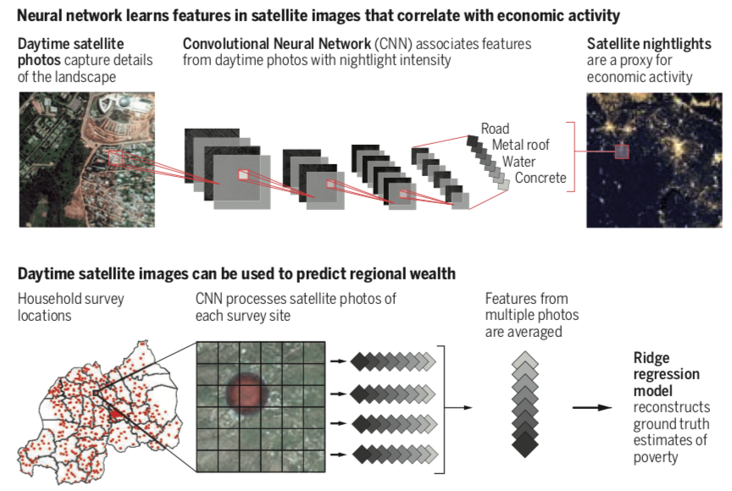
Example: Predicting poverty
Using day and night satellite data, survey data to predict poverty in locations without surveys (Jean et al Science 2018)
Blumenstock, Science (2016)
Notes:
In this work, researchers at Stanford built a model to use widely available data to drive predictions about how much money people in poor parts of the world have.

Slide 8
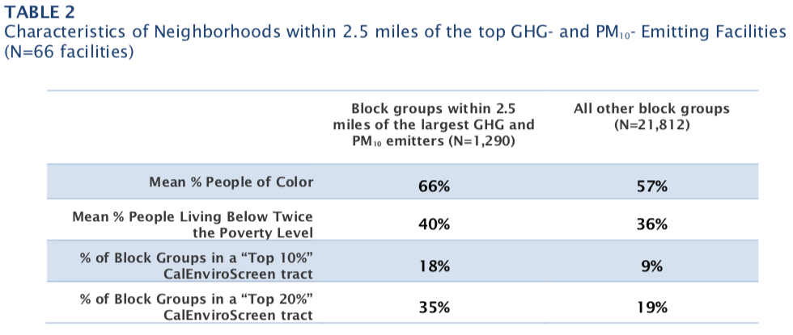
Example: CO2 emissions and Justice
Notes:
Data indicate heavy pollution sources in California
Have a high fraction of people of color living nearby
Have increased emissions since cap and trade began
What is the causal story here?
What should be *done* about the situation?
From Cushing et al, “A Preliminary Environmental Equity Assessment Of California’s Cap-and-Trade Program“ 2016

Slide 9
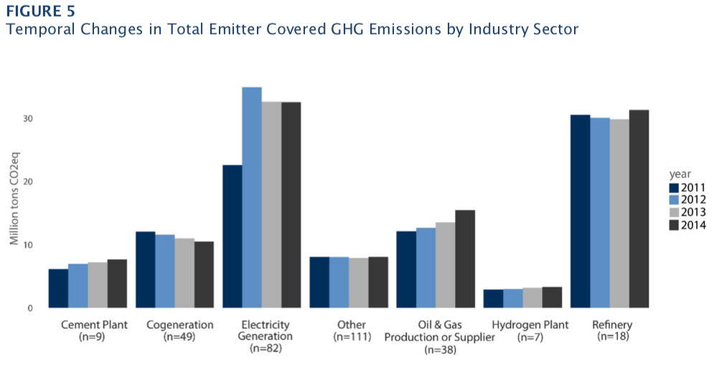
Example: CO2 emissions and Justice
Notes:
Data indicate heavy pollution sources in California
Have a high fraction of people of color living nearby
Have increased emissions since cap and trade began
What is the causal story here?
What should be *done* about the situation?
From Cushing et al, “A Preliminary Environmental Equity Assessment Of California’s Cap-and-Trade Program“ 2016

Slide 10
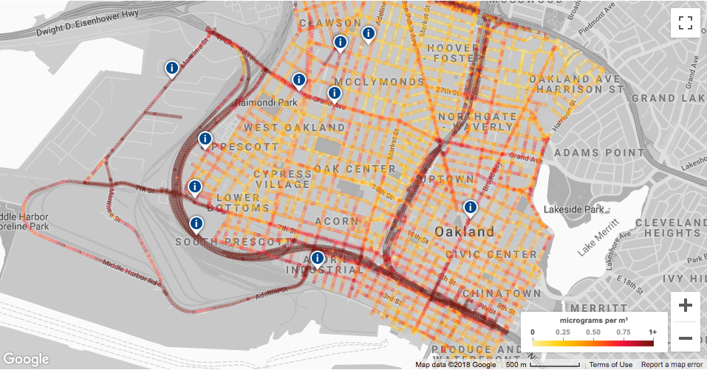
Example: Improving air quality assessments
Josh Apte (ERG PhD alum) partnered with Google, Environmental Defense and West Oakland Environmental Indicators Project to generate air quality data of unprecedented resolution

Slide 11
What is data science?
“Data science focuses on exploiting the modern deluge of data for prediction, exploration, understanding, and intervention”
--Blei and Smith (2017)
It is a mix of data, computing and statistics.
It is not only statistics: the algorithms have deep origins in computing and computer science
It is not only computing: one must understand the fundamentals of the origins and characteristics of data

Slide 12
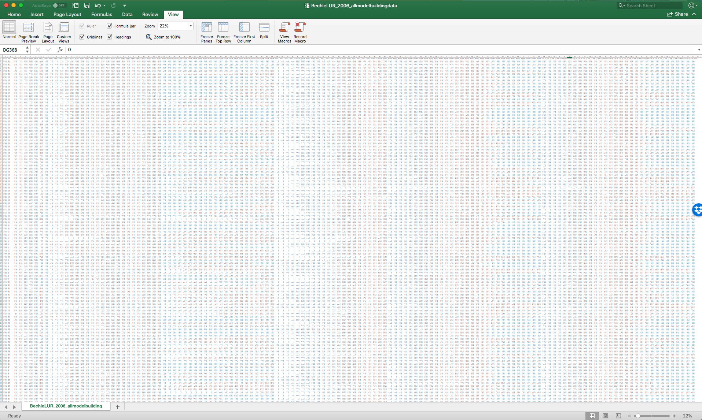
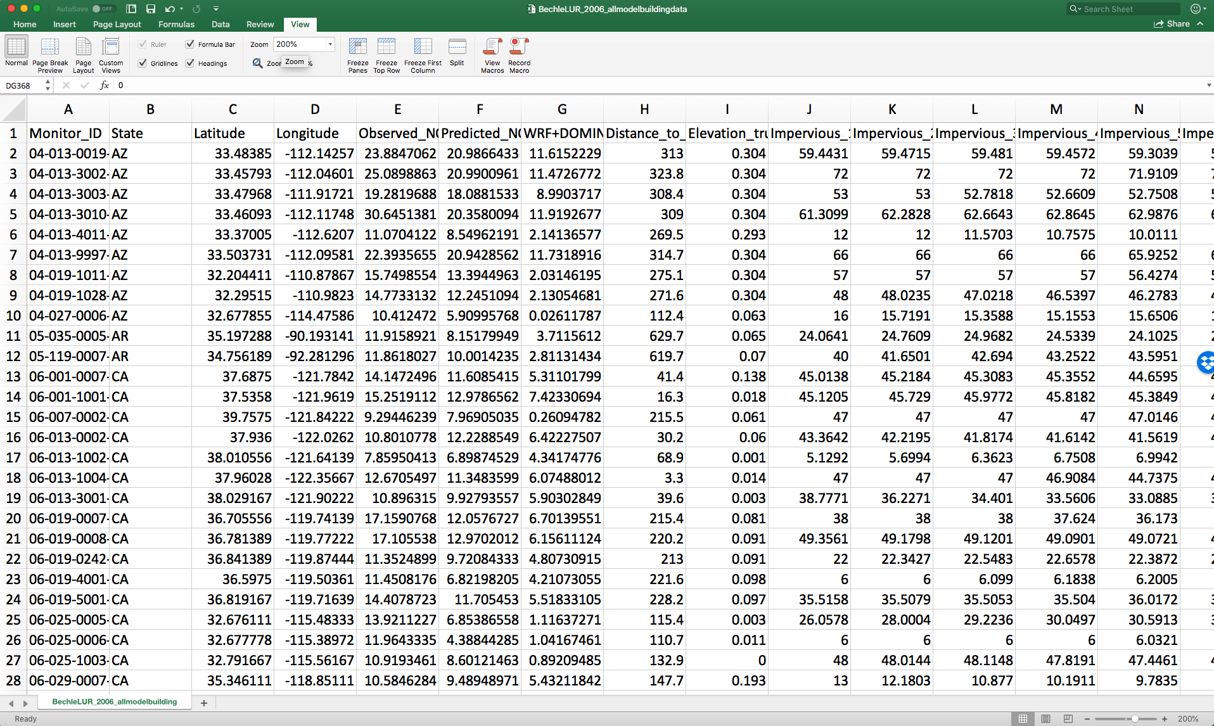
What does “big data” mean?
Two characteristics
Data sets are large (many data points in total, or cells in a spreadsheet)
Data sets are wide (many different categories of observations, or columns in a spreadsheet)
Many of the “data science” things we do in Python are things one could do in excel with small data sets.

Slide 13
What are those other buzzwords?
Artificial intelligence
Machine Learning
Statistical Learning
These refer to processes to build models that use data to learn from and make decisions about the world based on available observations.
We’ll learn from a statistical learning textbook, and many of the tools we use are also known as machine learning.

Slide 14
Is data science a fad?
My perspective: The kinds of data, tools and computing environments we will study in this course will not go away any time soon. We may organize them under different structures, but we won’t stop using them.

Slide 15
What can we do with data science? Rain dances vs. Umbrellas
(adapted from Kleinberg AER 2017)
Consider two policy makers studying rain
One seeks to understand if a rain dance will make it rain
One seeks to decide whether or not to invest in umbrellas
Both require models and data, but
“Rain dance” problems are impact analyses. The seek to identify a causal effect.
We call “umbrella” problems resource allocation problems. They seek to predict the future so people can decide where to allocate resources and effort.
(amazon.com)

Slide 16
Is prediction enough for resource allocation?
(Adapted from Susan Athey’s 2017 Science article.)
Consider a scarce resource: Environmental health and safety inspectors at CalEPA.
If one could predict which chemical facilities are likely to have an unplanned toxic release, one could dispatch inspectors to those locations
Why might this be a bad strategy?
The behavior of the facilities being inspected might change during an inspection.
The cost to remedy identified problems might be different at different locations, which might make some problems less likely to be solved.
(mssu.edu)

Slide 17
The importance of context and narratives
From Pastor’s 2007 article in Reclaiming Nature on Environmental Justice (EJ):
“Traditional environmentalists tend to favor ‘rational’ processes of debate objective scientific research on hazards and their risks…such frameworks tend to produce negotiation between businesses and their hired experts…”
“EJ activists favor ‘democratic’ epistemologies in which community participation facilitates story-telling about lived experiences…in the minds of many EJ advocates, this allows for community empowerment.”
Which is right?
Notes:
“rational” processes:
when done right, can have greater objectivity. They promote science based decision making.
when done wrong, they exclude vulnerable populations without access to data or training. The people impacted by the polluting activity can’t get a seat at the decision making table.
“democratic” epistemologies on the other hand
facilitate engagement by those affected by pollution.
lack the credibility of the ”rational” process.
However they enable people to capture factors that science can’t – for example anecdotes about what it means to grow up in the shadow of a refinery.

Slide 18
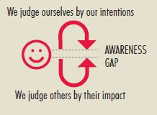
What’s the awareness gap?
For many in the room, talking about these issues is abstract, but for others it may not be
We will discuss ideas about intent vs impact, for example in identifying environmental racism
It is also important to think about intent vs impact in the words we use.
…it matters little if you have the best of intentions if your actions still have a negative or unfair impact on others
calliopelearning.com
Notes:
It’s important for us to
Do our best to be aware of the impact our words will have on others
But also to be aware that others don’t always understand the impact of their words on ourselves.

Slide 19
What are the course objectives?
Teach students to build, estimate and interpret models that describe phenomena in the areas of energy & environmental decision-making.
We will
Focus on analysis and prediction
Learn a suite of data-driven modeling approaches
Build the programming and computing skills to use those models (in Python and Jupyter notebooks)
Develop the expertise to formulate questions that are appropriate for available data and models.
Students will leave the course as both critical consumers and responsible producers of data driven analysis.

Slide 20
What will we do in this course?
Let’s review the syllabus

Slide 21
How does this course fit into Berkeley’s curriculum?
Students must have
Data 8 before enrolling.
Calculus (required, and in recent memory or use)
Other courses that would be useful:
An introductory programming course (CS61A or CS88).
Linear Algebra (Math 54, EE 16a, or Stat89a)
The course is designed to fit into Berkeley’s emerging “data science” curriculum. It is similar to Data 100.
But we will place a stronger emphasis on how to use prediction methods as decision-making tools in energy and environment contexts
It has less emphasis on web technologies, working with text, databases and statistical inference.
Can be used for the domain emphasis of the DS major, and for ERG’s minor

Slide 22
What resources are required?
Hardware: You’ll need a laptop.
Mac, Windows, Linux, Chromebook all ok.
If you don’t have a laptop please see me or Seigi after class.
Software:
All work can be done in the cloud, on Berkeley’s datahub
If you wish, you can install Python locally with the Anaconda distribution.
We’ll use Python 3.x
Read-ware:
Introduction to Statistical Learning, available as PDF or for sale from online retailers.
The DS100 online textbook
Other reading will be distributed through bCourses.

Slide 23
Datahub vs Anaconda
For labs and homeworks, we’ll give you links that load the required files into your own account on datahub.berkeley.edu
Sign in with your calnet ID!
If you wish, you can install a local version of Python and a starter package of data science libraries with the “Anaconda” distribution
See http://www.ds100.org/sp18/setup for instructions on how to do this.
If you encounter problems running a notebook, the first thing we’ll ask is “is it working on datahub?”
We can’t provide support if the answer is yes…

Slide 24
How are students evaluated?
Homework (20%). Submission by submitting pdf of Jupyter notebook. 11 assignments, we drop the lowest grade.
Labs (20%). Submission by submitting pdf of Jupyter notebook. 11 assignments, we drop the lowest grade.
Mid term (25%).
Final (25%).
Attendance and participation (10%)
We’ll measure attendance and participation by doing short quizzes in each lecture.

Slide 25
A short quiz
Go to bCourses
Under ”quizzes” on the left, choose “Quiz 1”
Enter access code
Answer the two questions and submit

Slide 26
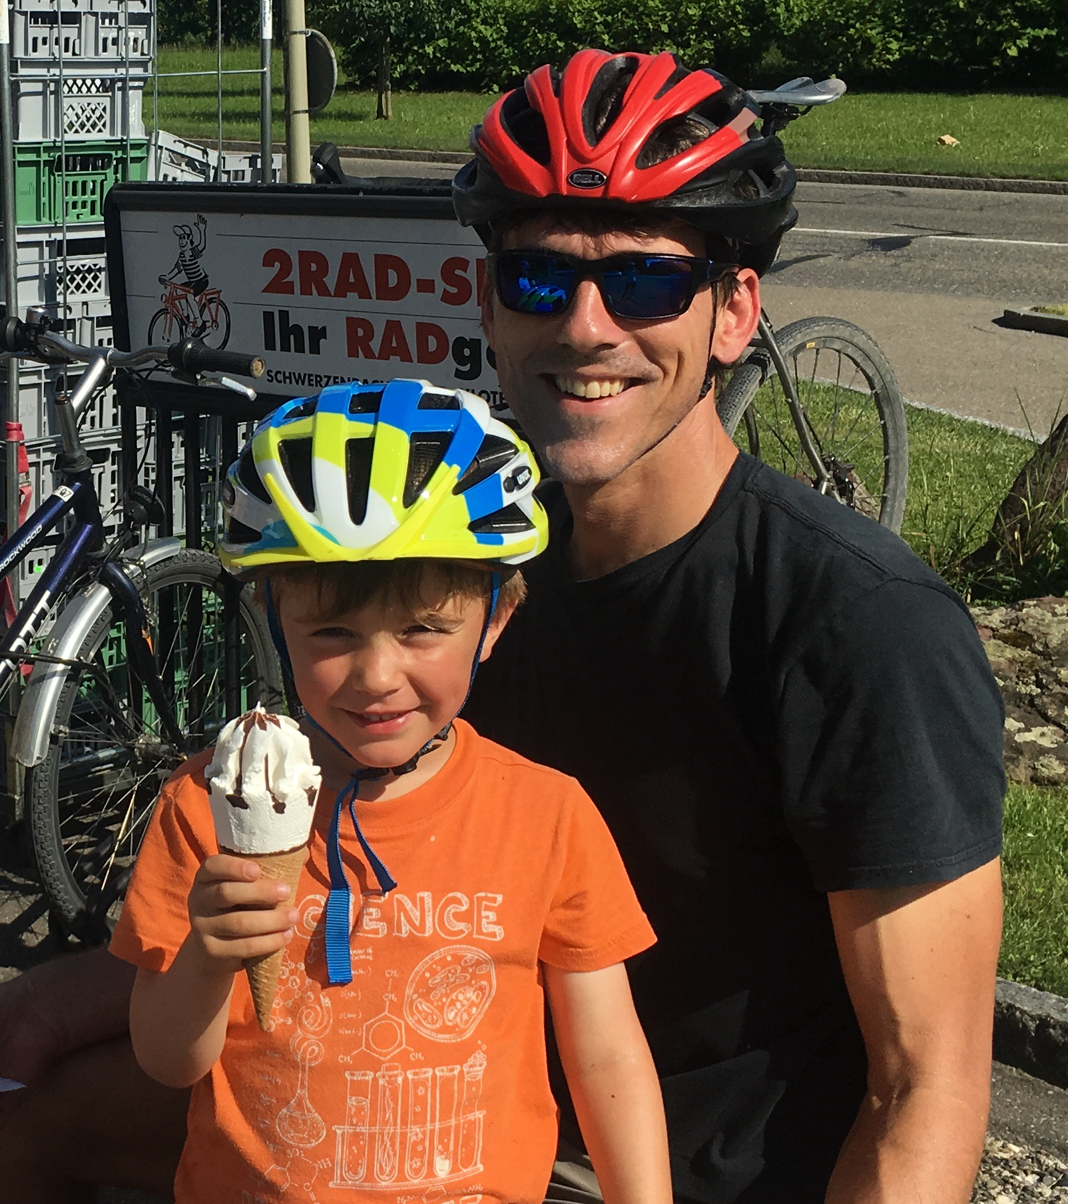
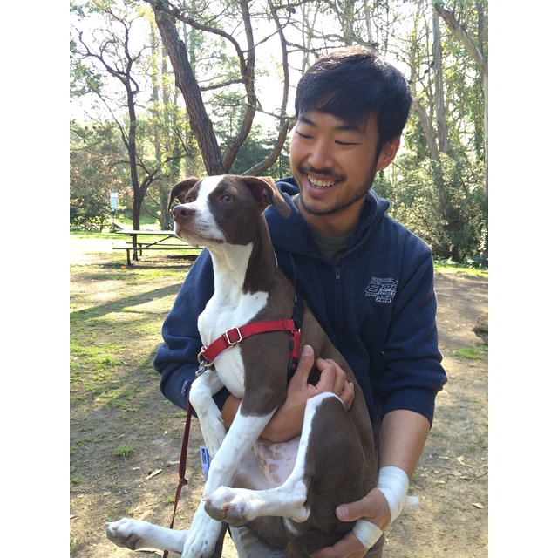
Who are the instructors?
Duncan Callaway Seigi Karasaki

Slide 27
When and where?
Lectures: Tu/Th 9:30-11, Wheeler 102
Labs: Mo 10-12, Barrows 110
Office hours
Duncan (Barrows 310): We 3-4, by appointment; Th 11:15-12:15, open door.
Seigi (Barrows 399): Mo 12-1, open door
Labs due Fridays, pdf upload to bCourses
HWs due Tuesdays before class, pdf upload to bCourses

Slide 28
Next week
Monday 8/27:
Lab @10a in Barrows 110.
Bring your laptop!
Lab notebook will be due Friday.
Tuesday 8/28:
Reading: Science and Data Science, available on bCourses
Lecture: Bring your laptop!
(Talk to Duncan or Seigi if you don’t have one)
HW1 assigned, due the following Tuesday 9/3
Thursday 8/30
Reading: Chapter 3 from the DS100 textbook
Lecture: Again, bring your laptop!

